Slide 1

Security System
Arduino uno and ultrasonic sensor
Name: Henok Daniel - 100053694
Instructor: Dr. Abdulhadi Shoufan
Submission Date: 04/05/2023

Slide 2
Goal of project
This project aims to design a Security system using Arduino Uno.
The purpose of this project is to guard against unwanted intruders.

Slide 3
Project description
Uses a Button to turn the whole system on/off.
Uses Ultrasonic sensor to measure distance .
Lights LEDs as an object crosses 3 set distance thresholds.
Buzzer makes sound whenever the object is within any of the distance thresholds
LCD displays the distance of the object from the sensor.

Slide 4
Used Components
Arduino Uno
Ultrasonic sensor
LCD display
Breadboard and jumper wires
Push button
Buzzer
LEDs

Slide 5
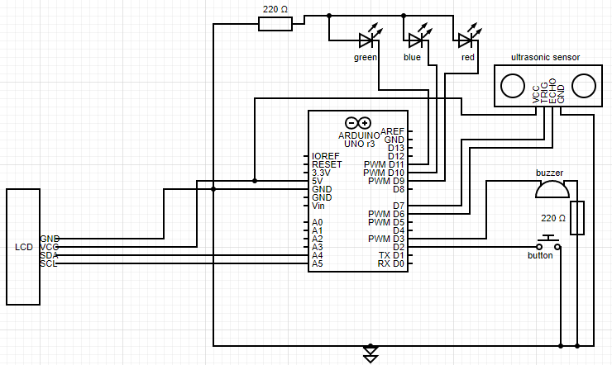
Circuit Schematics

Slide 6
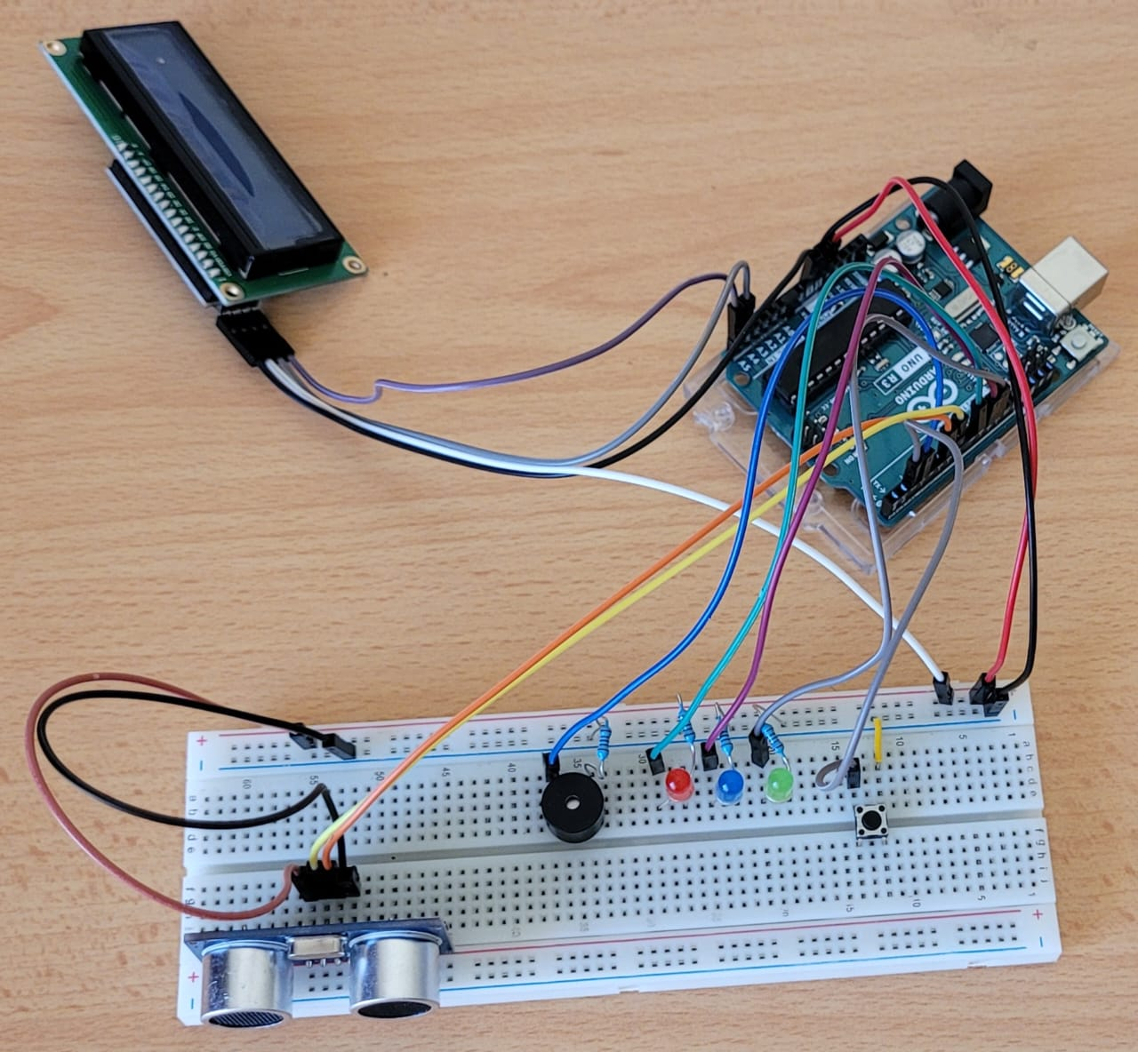
Real schematics

Slide 7
Software Flowchart
Button turns on the system
Ultrasonic sensor continuously measures distance
LCD simultaneously displays measured distance
Green LED lights up if distance is less than 50 cm
Buzzer sounds if distance is less than 50 cm
Blue LED lights up if distance is less than 20 cm
Red LED lights up if distance is less than 10 cm
Button turns off the system

Slide 8
Conclusion
Security system is cheap to make and easily mobile
It can be applicable in homes or any other building
Arduino Uno can be used for several applications
It has a vast of available library
It is compatible with many devices

